Slide 1
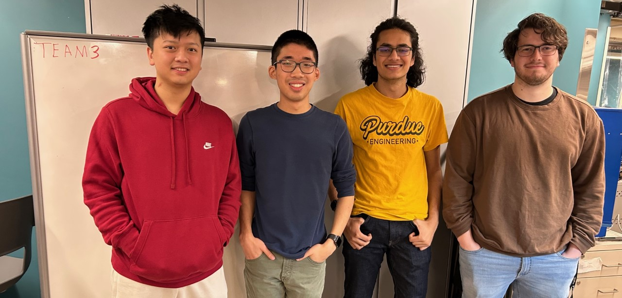

ECE477 MIDTERM DESIGN REVIEW: TEAM #3

Slide 2
OUTLINE
Project Overview
Major Components
Block Diagram
Packaging Design
Electrical Schematic
PCB Layout
Prototyping Progress
Software Development Status
Project Timeline
Questions

Slide 3
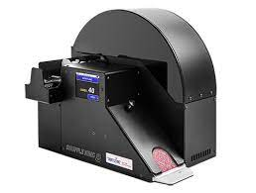
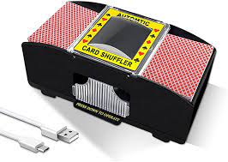
PROJECT OVERVIEW
Automatic Card Shuffler
Allows user to specify deck order or winner
Scans cards and inserts them in calculated order
Cards drop out onto deck in order
Uses computer vision to identify cards
Uses motors to place card in predetermined slot
UI through LCD and Button Inputs
Middleground cost-wise
Notes:
Brian

Slide 4
PSSCs
PSSC #1 (Hardware): An ability for a microcontroller to operate multiple DC motors connected to a high-friction roller to consistently take only the bottom card off a deck with an error-free rate of at least 90%.
PSSC #2 (Hardware): An ability for a microcontroller and the Raspberry Pi to communicate via a UART transmission line.
PSSC #3 (Hardware): An ability for a microcontroller to control a stepper motor to precisely rotate the shuffling wheel.
PSSC #4 (Hardware): An ability for a microcontroller to control an LCD screen via SPI to display device status and user inputs.
PSSC #5 (Software): An ability for the Raspberry Pi to determine the rank and suit of individual cards with an accuracy of 75% or higher by taking a picture of it and processing the image.
Stretch Goal #1 (Software): An ability to host a web server on the Raspberry Pi that, when connected to via WiFi, provides a web interface for the user to input desired settings and control the device.
Stretch Goal #2 (Software): An ability to recognize when a previous image recognition was performed incorrectly and error correct by altering the output order accordingly.
Stretch Goal #3 (Software): An ability to perform generalized card recognition, i.e. recognize cards other than standard size print Bicycle playing cards.
Notes:
List your team’s PSSCs in this section. This slide is intended to be used for reviewer reference only, and should be passed over during the actual presentation (as there are more important things to be discussed)

Slide 5
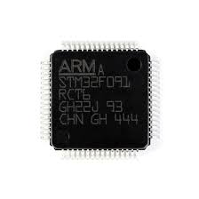
MAJOR COMPONENTS
Microcontroller Selection
Processor used in embedded systems for low power and processing requirements
Used for interfacing with UI and Motors
User Interface uses SPI for LCD screen and GPIO for buttons
OPM and GPIO used to interface with motors
Specifications (for chosen STM32F091RCT6):
Clock Speed = 48 MHz
# of GPIO Pins = 52
# of SPI Connections = 2
# of UART Connections = 8
# of Timers = 12
Operating Voltage = 3-3.6 V
Notes:
Zach

Slide 6
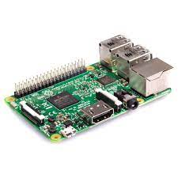
MAJOR COMPONENTS
Single Board Computer Selection
Standalone processor for auxiliary/computationally intensive software operations
Holds system’s core intelligence
Using image data to recognize cards
Finding ‘user specification’-compliant card arrangements
Specifications (for chosen Raspberry Pi 3 B):
Price = $35
CPU = ARM Cortex-A53 @ 1.2GHz
GPU = Dual Core VideoCore IV Multimedia Co-Processor
Memory = 1GB LPDDR2
# of GPIO Pins = 28
Power Constraints = 5V @ 2A
Other features:
UART, Display Interfaces (i.e. HDMI), Camera Interface
Notes:
Utkarsh

Slide 7
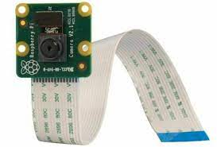
MAJOR COMPONENTS
Camera Selection
Independent camera module for card image capture within device
Captures images of cards for identification via SBC
Priorities: (1) Compactness (2) Ease of integration (3) Price
Specifications (for chosen Raspberry Pi Camera Module v2):
Price = $25
Dimensions = 25 × 24 × 9 mm
Sensor = 8 megapixel Sony IMX219
Focal Length/FOV = 3.04 mm, 62.2°
Data Output Format = YUV array
Connection Interface = RasPi Ribbon Connector
Other features:
Official camera for chosen SBC (high integrability)
Notes:
Utkarsh

Slide 8
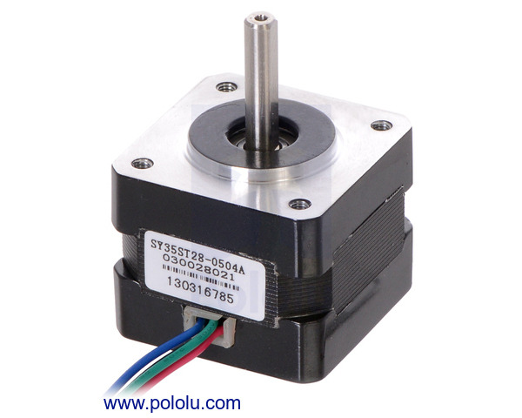
MAJOR COMPONENTS
Stepper Motor Selection
Motor that allows for fine control over rotation
Used for controlling card separation
Control card holding wheel
Push cards off bottom of deck
Specifications (for chosen Nema 14):
Step Size = 1.8 degrees
Voltage = 10 V
Current = 0.5 A/Phase
Holding Torque = 14 oz*in
Notes:
Brian

Slide 9
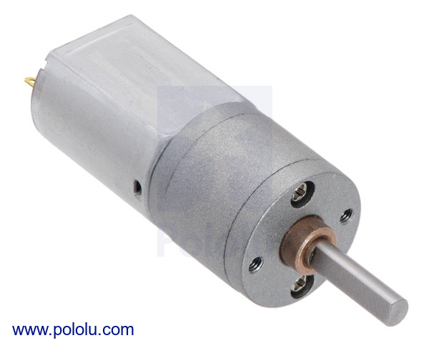
MAJOR COMPONENTS
DC Motor Selection
Motor that allows easy use through DC voltage
Used for card separation
Push cards into card wheel
Specifications (for chosen 31:1 Metal GearMotor):
Voltage = 6-12V
No-Load Current = 0.08 A
No-Load Speed = 450 rpm
Stall Current = 1.6 A
Stall Torque = 1.4 kg*cm
Notes:
Brian

Slide 10
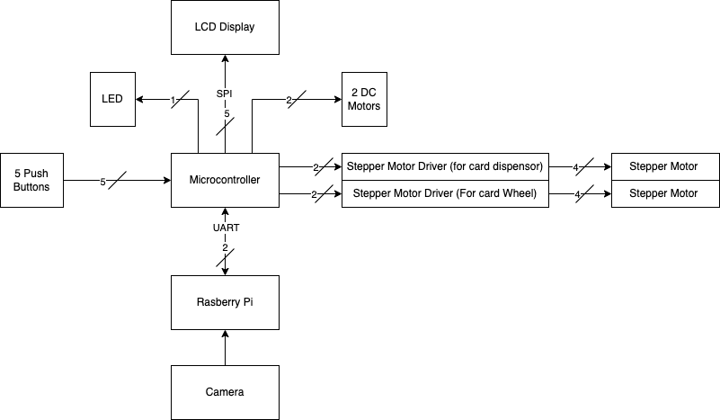
BLOCK DIAGRAM
Overall Electrical Diagram
Notes:
Utkarsh

Slide 11
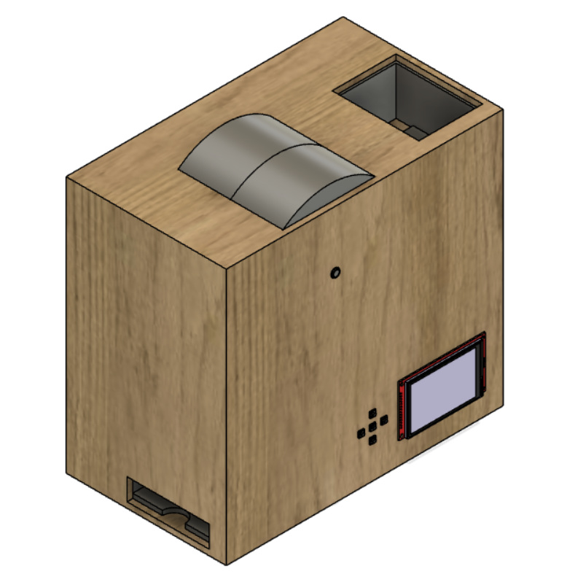
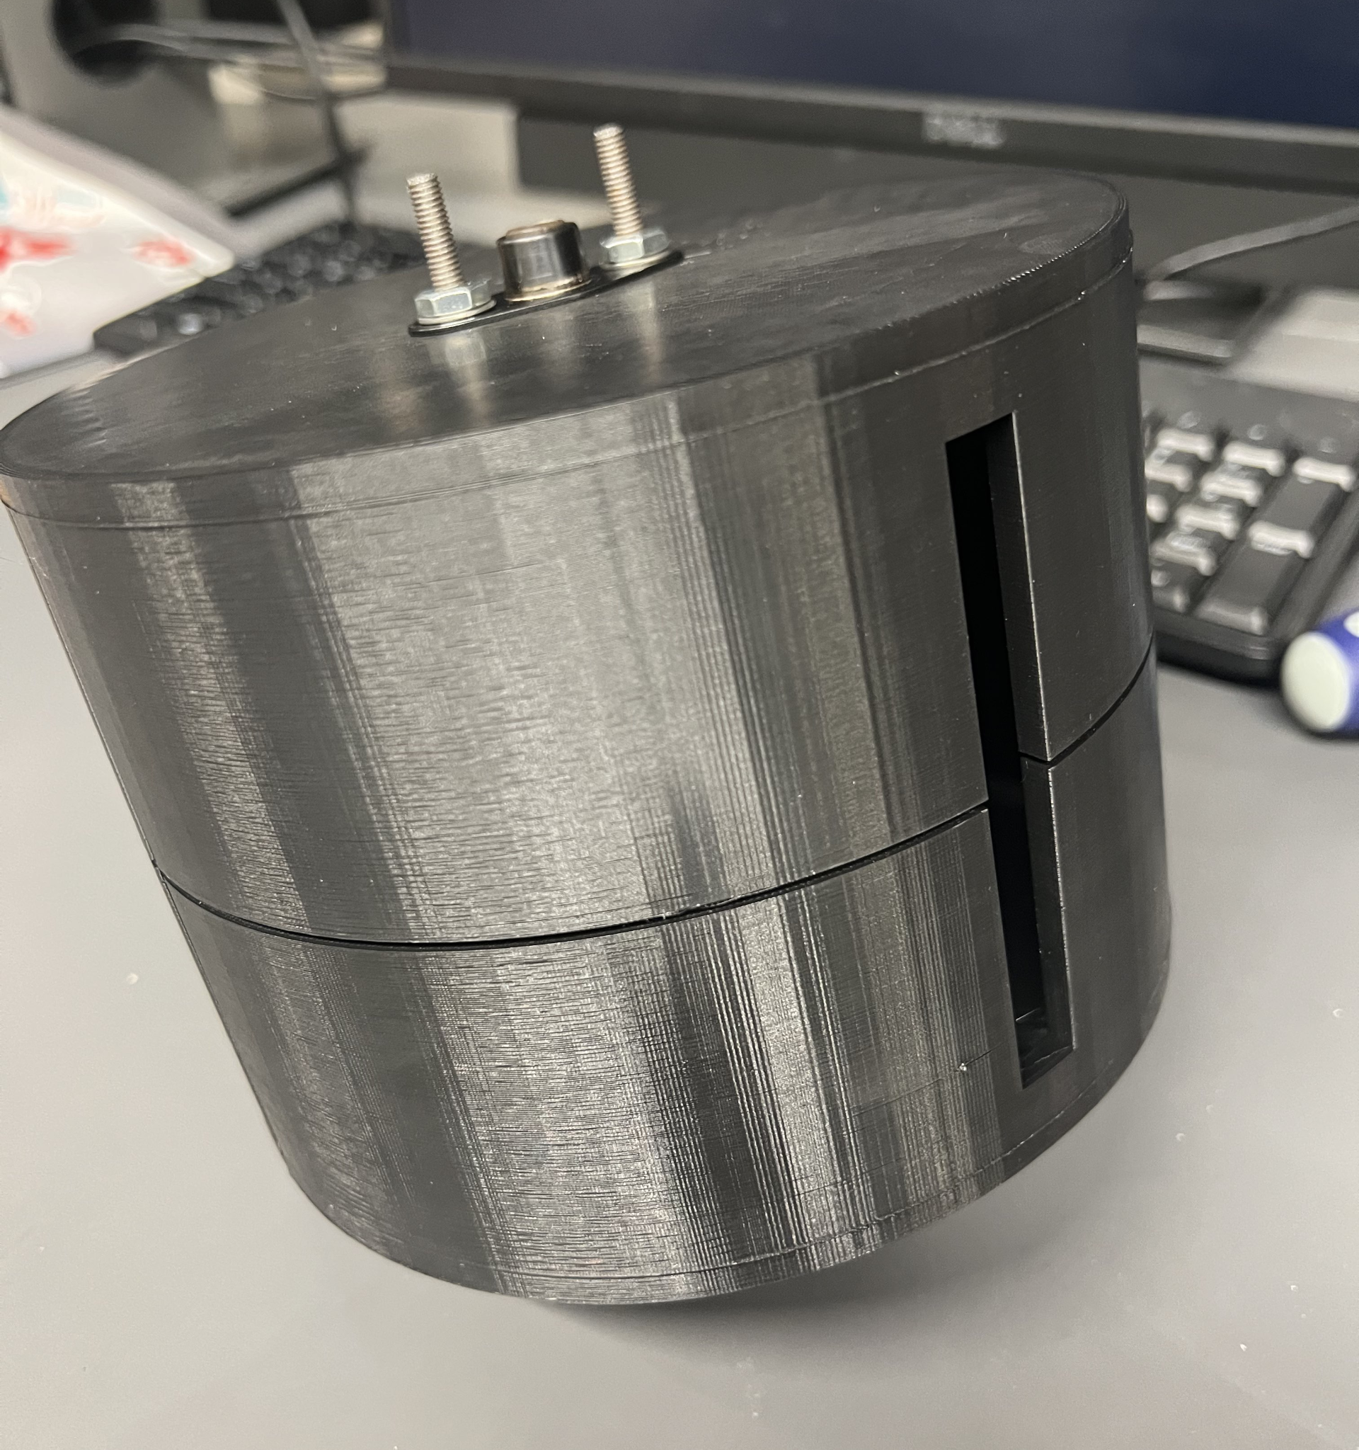
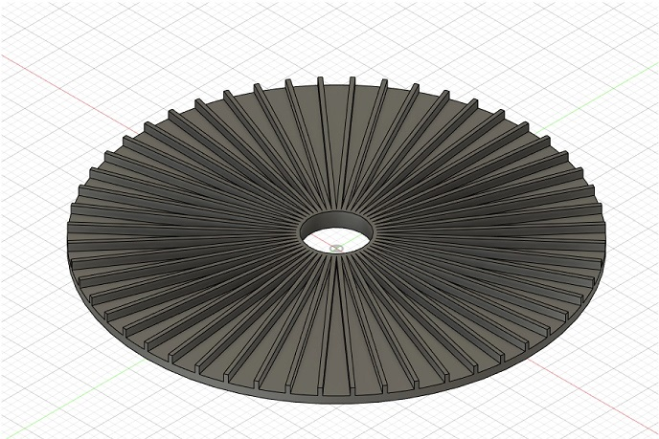
PACKAGING DESIGN
Overview
Total Package Dimensions: 12.1” x 8.4” x 12.0” (L x W x H)
PCB Dimensions: 4.45” x 2.25”
Wood for outer packaging
High strength
Easy to mount components
3D printed plastics for some inner components
Card wheel, wheel housing, card hopper, card collector
Higher precision in manufacturing
Large stable base
Notes:
Brian

Slide 12
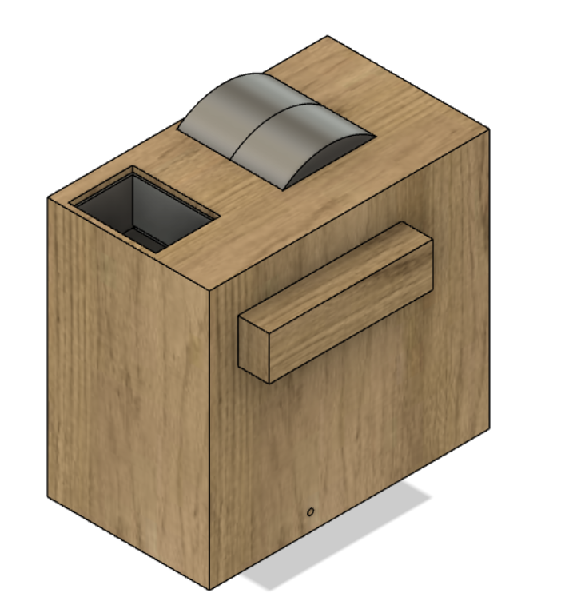
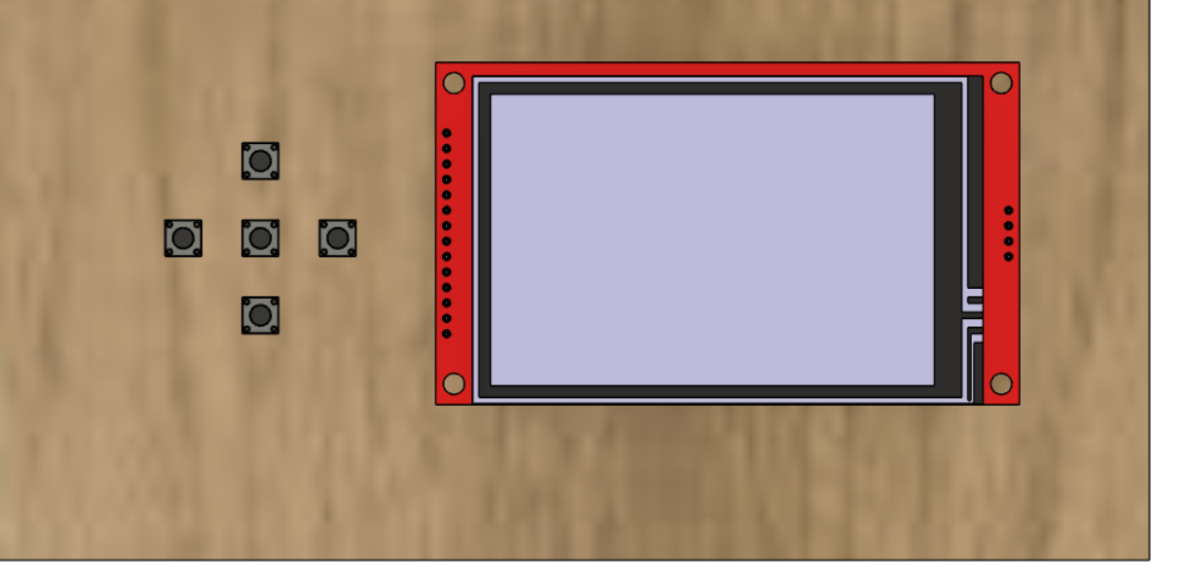
PACKAGING DESIGN
Outer Package
Notes:
Brian

Slide 13
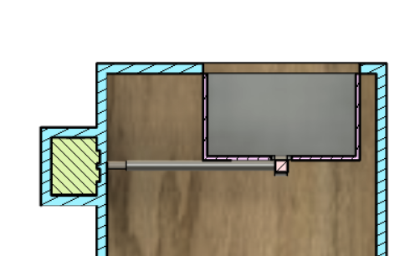
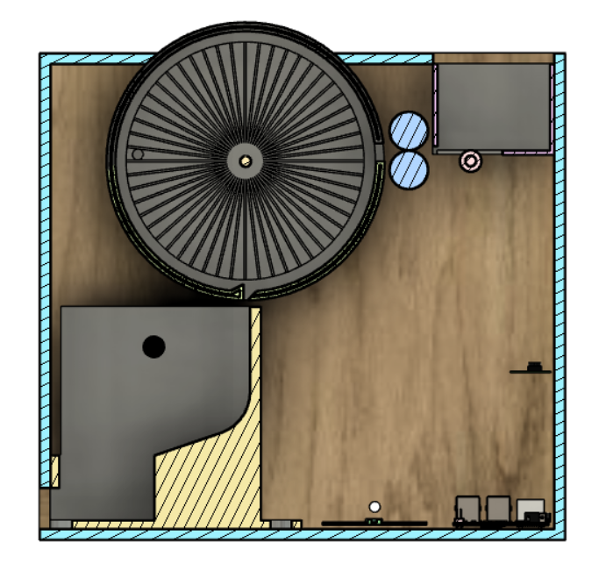
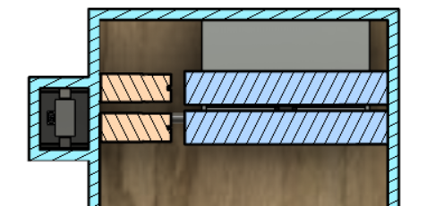
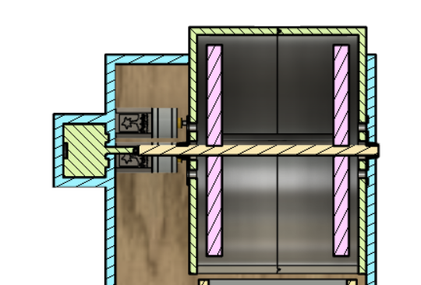
PACKAGING DESIGN
Mechanical Component Positioning
Notes:
Brian

Slide 14
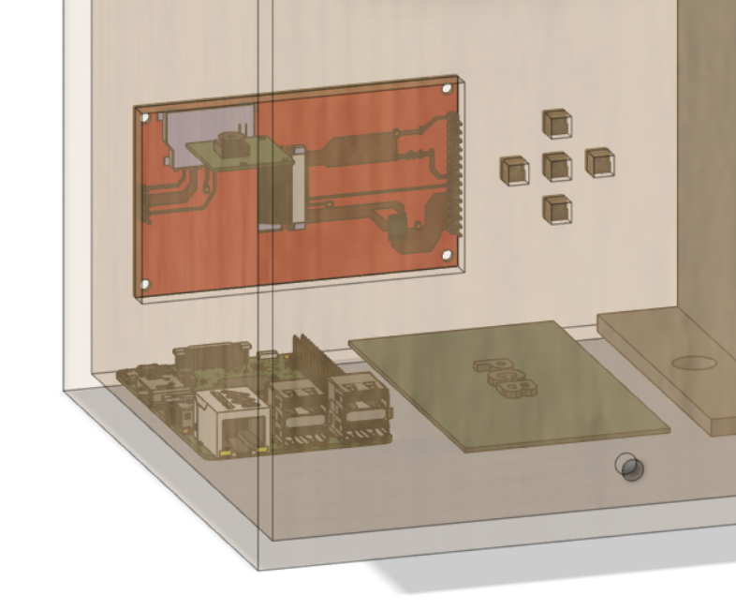
PACKAGING DESIGN
Electrical Component Positioning
Notes:
Brian

Slide 15
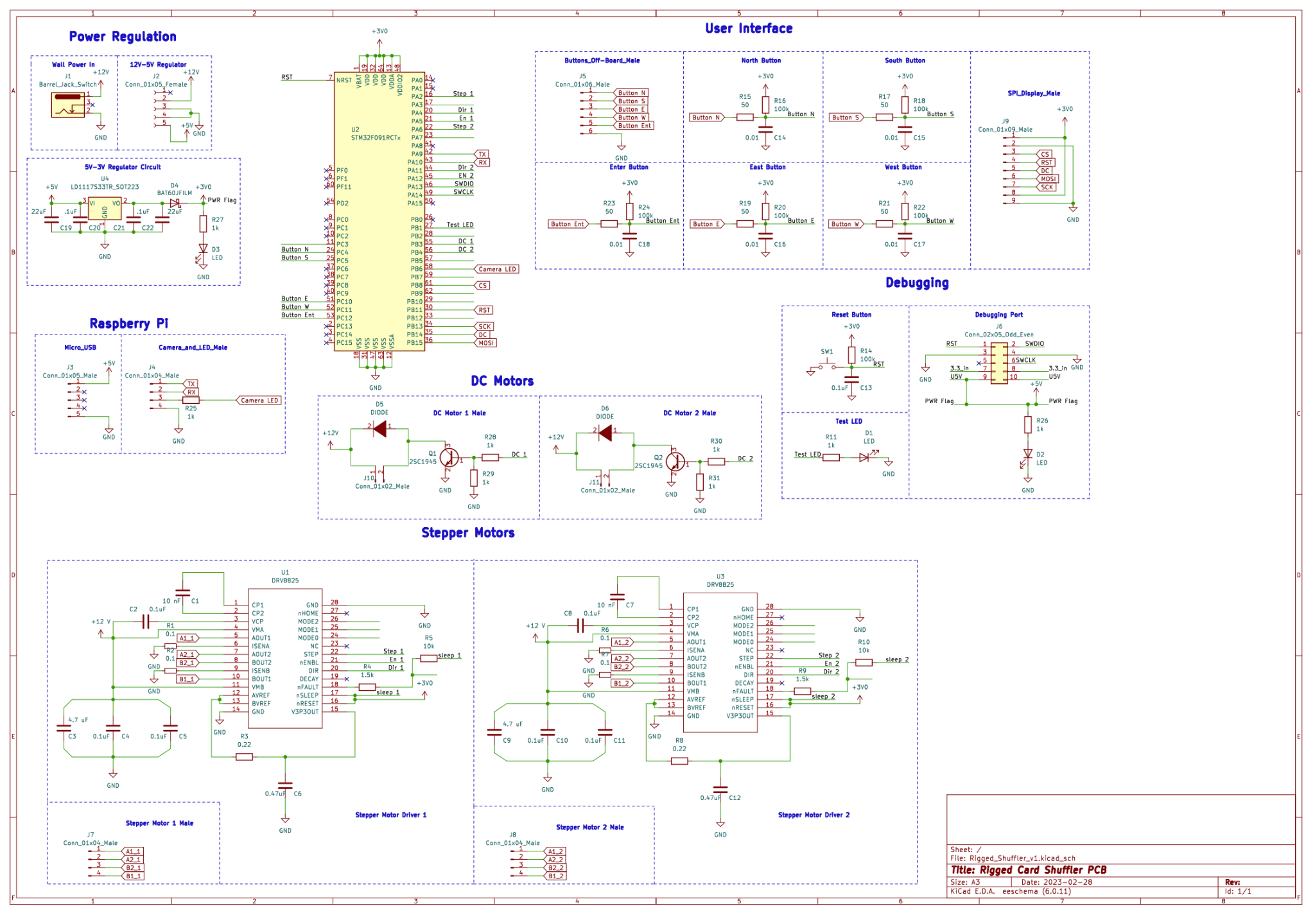
ELECTRICAL SCHEMATIC

Slide 16
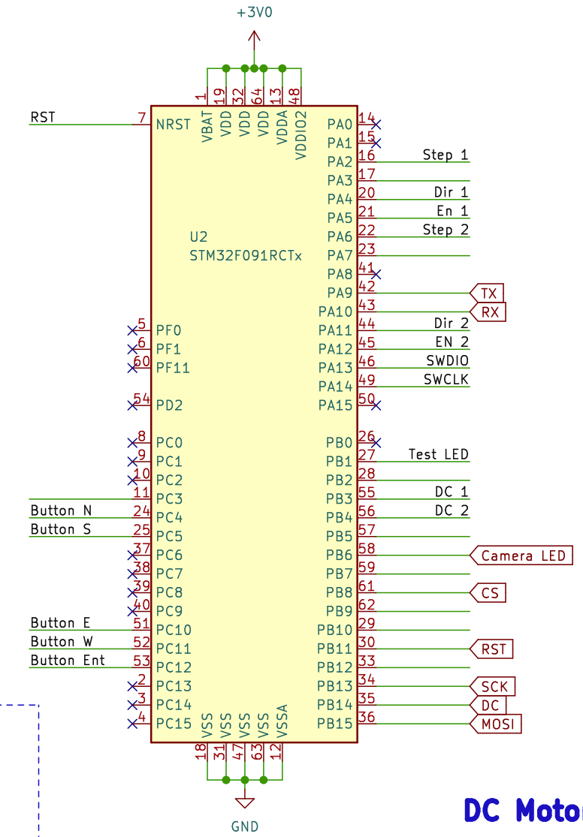
ELECTRICAL SCHEMATIC
STM32
Notes:
Zach

Slide 17
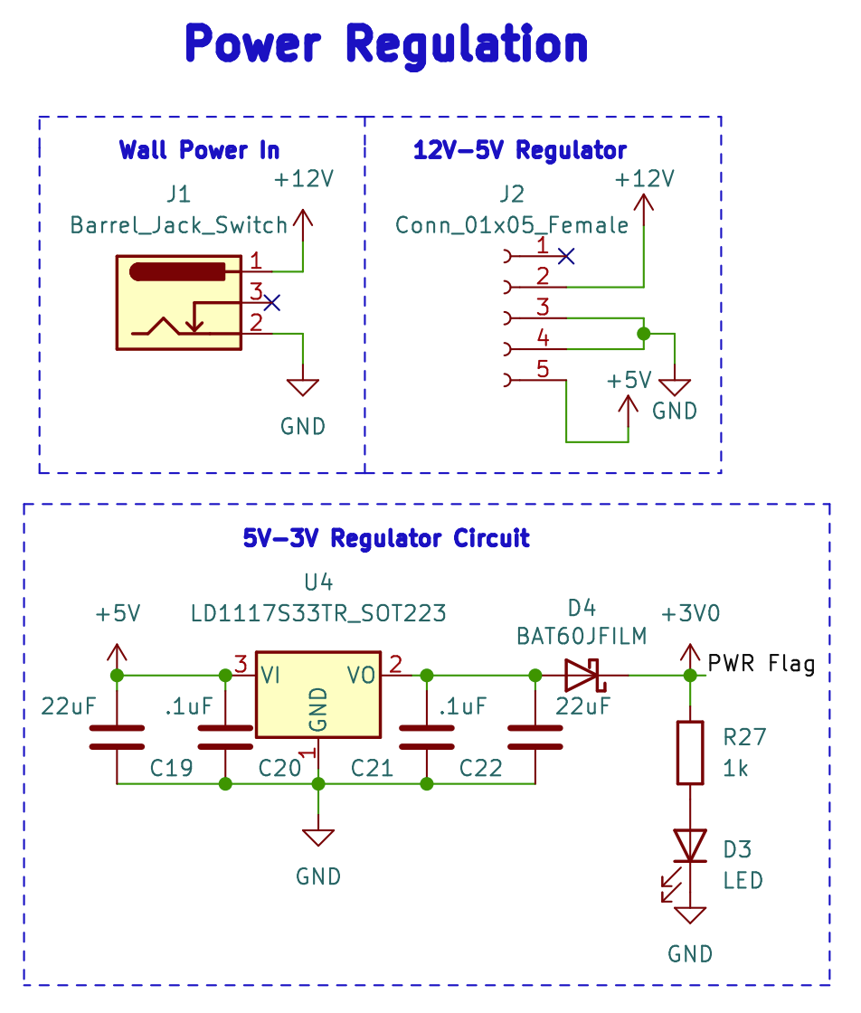
ELECTRICAL SCHEMATIC
Power Regulation
Notes:
Zach

Slide 18
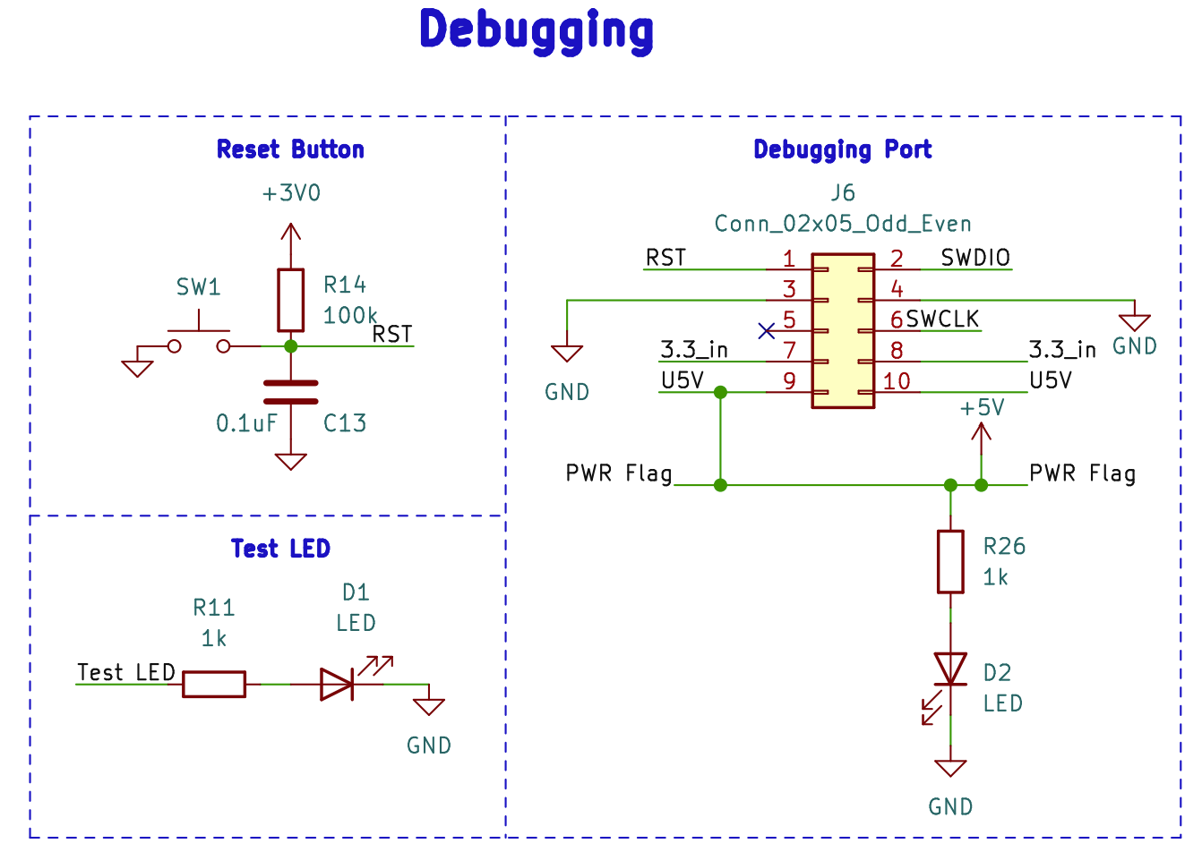
ELECTRICAL SCHEMATIC
Debugging
Notes:
Zach

Slide 19
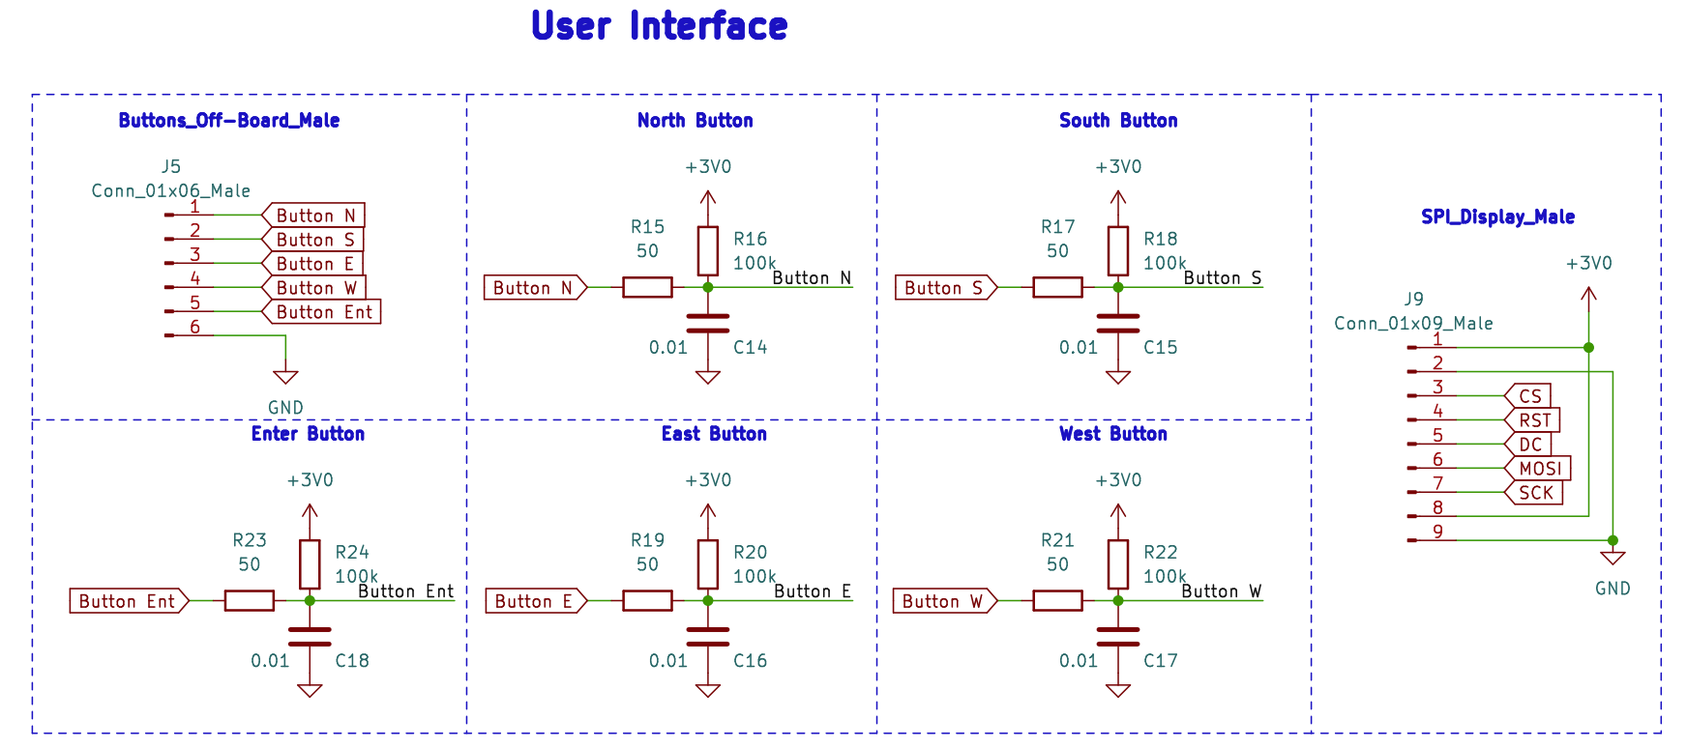
ELECTRICAL SCHEMATIC
User Interface
Notes:
Zach

Slide 20
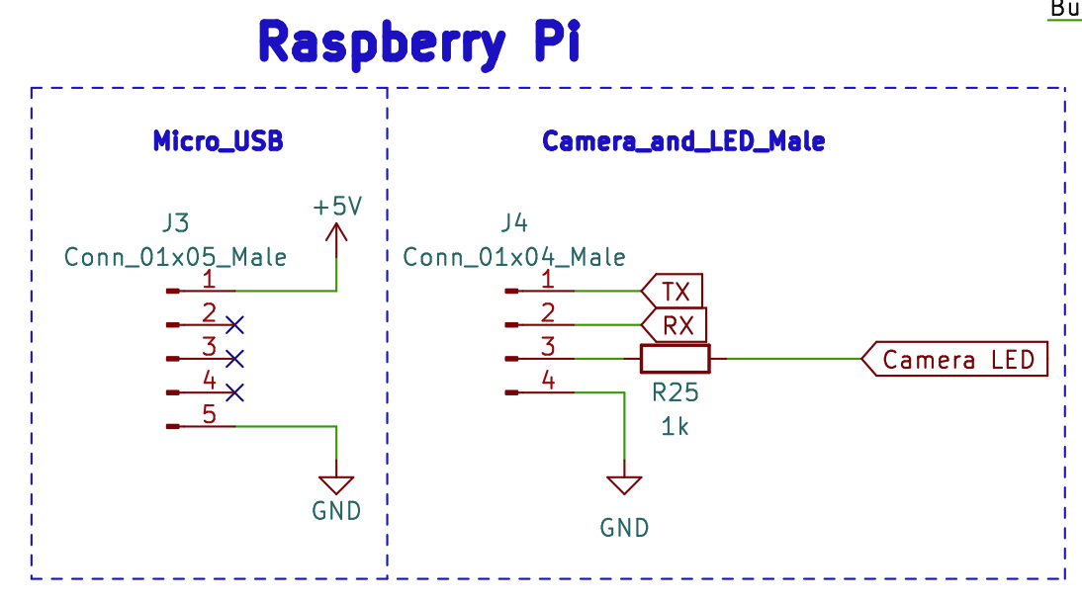
ELECTRICAL SCHEMATIC
Raspberry Pi
Notes:
Zach

Slide 21
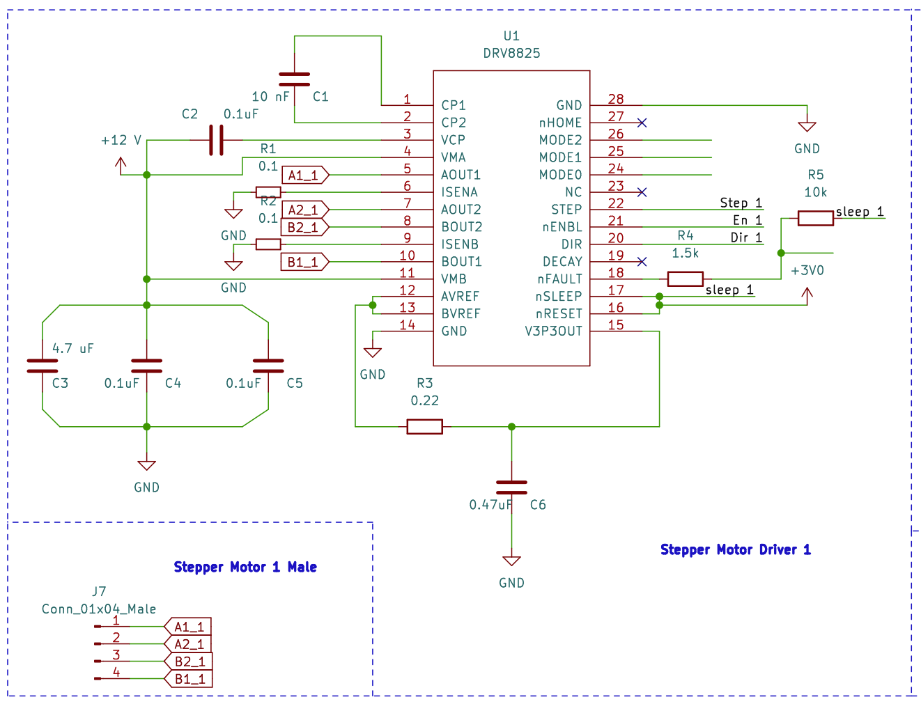
ELECTRICAL SCHEMATIC
Stepper Motors
Notes:
Dan

Slide 22
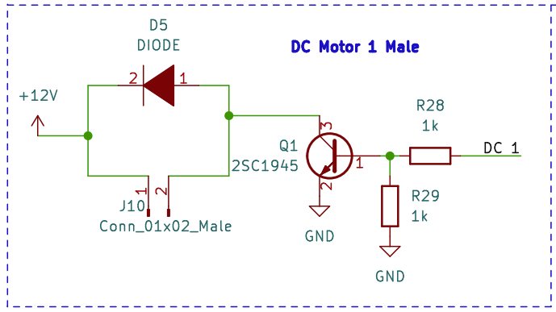
ELECTRICAL SCHEMATIC
DC Motors
Notes:
Dan

Slide 23
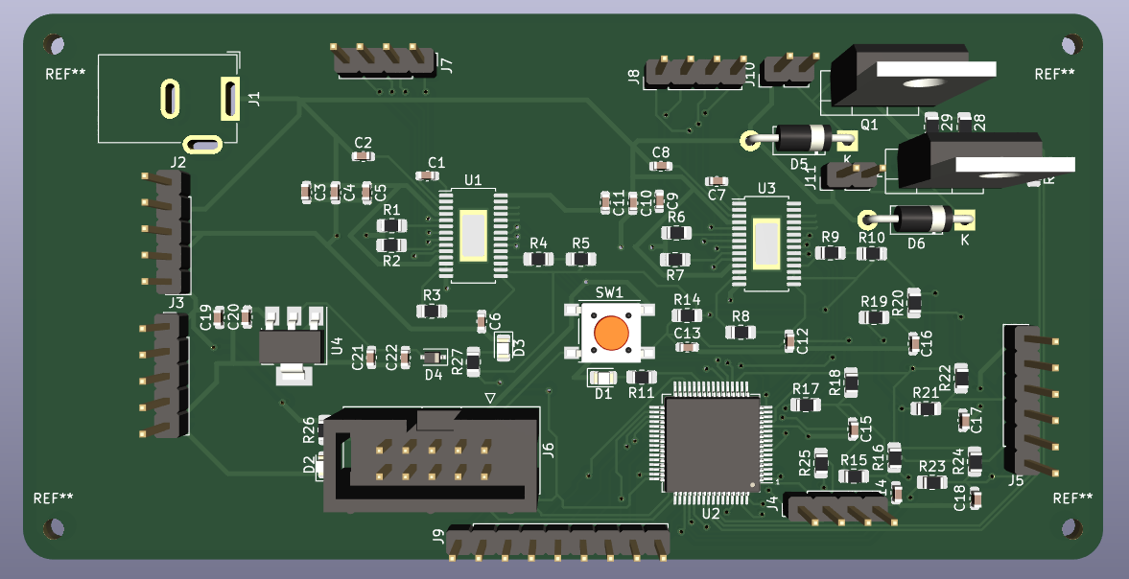
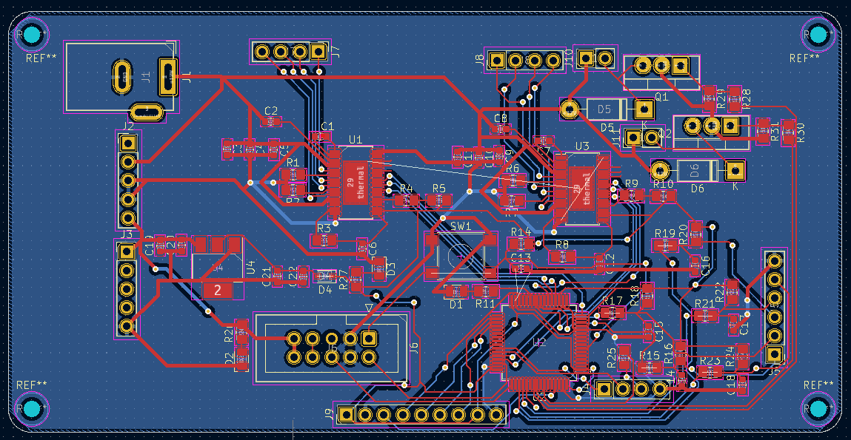
PCB LAYOUT
Overview
Notes:
Dan/Zach

Slide 24
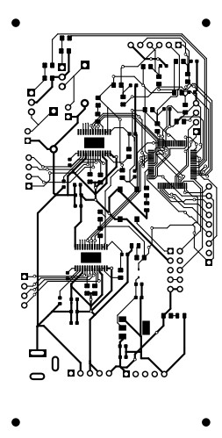
PCB LAYOUT
0805 Caps and Resistors
All off board components have a 2.54mm pin
Different Wire Widths
0.5 mm 12V, 5V, and GND
GND is 0.25 mm for STM
0.25mm for data
Bottom Copper layer is to GND
Silkscreen contains all component names

Slide 25
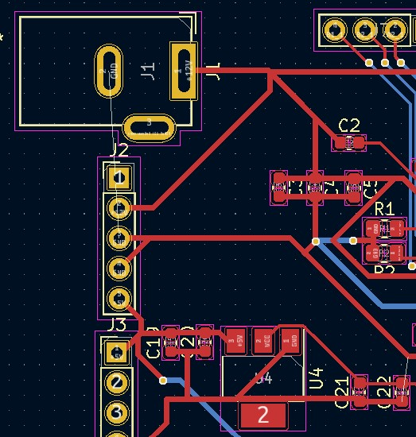
Power

Slide 26
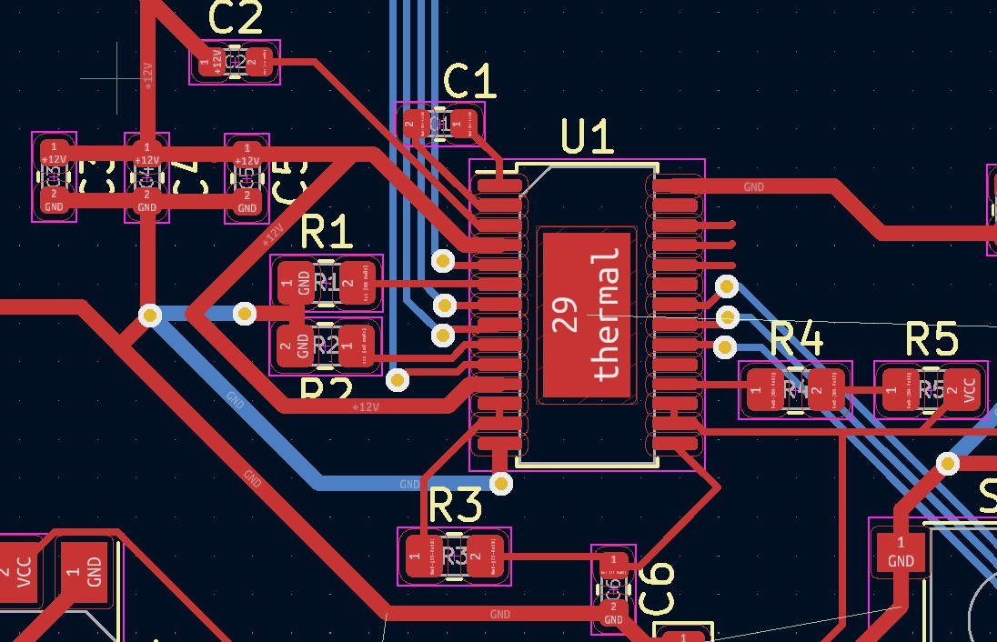
Stepper Motor

Slide 27
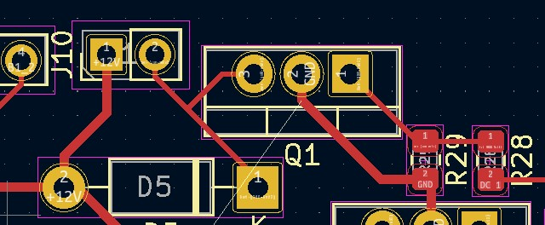
DC Motor

Slide 28
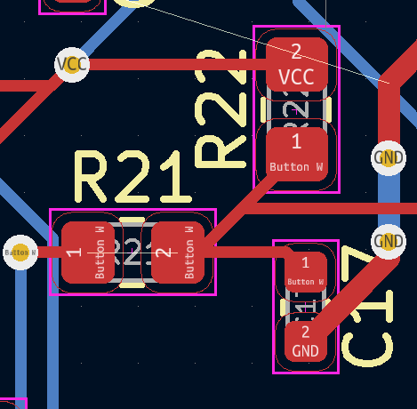
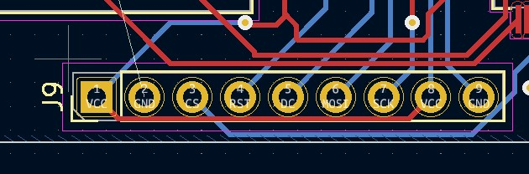
UI

Slide 29
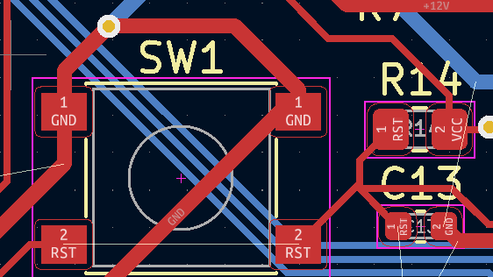
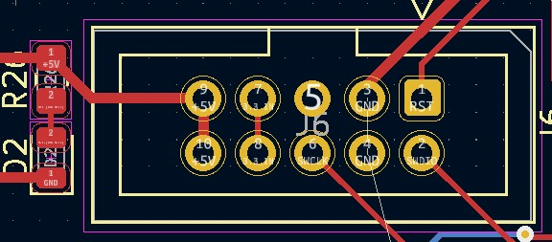
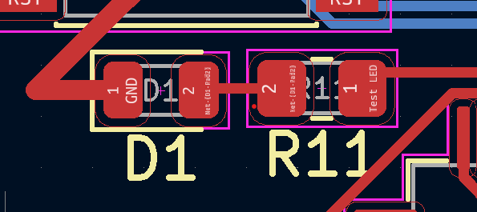
Programming

Slide 30
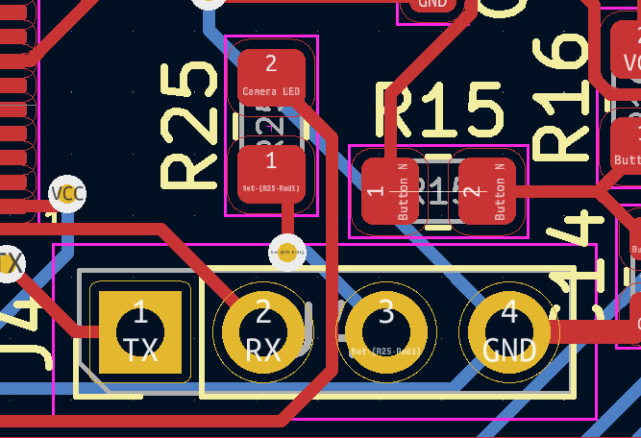
Rasberry Pi

Slide 31
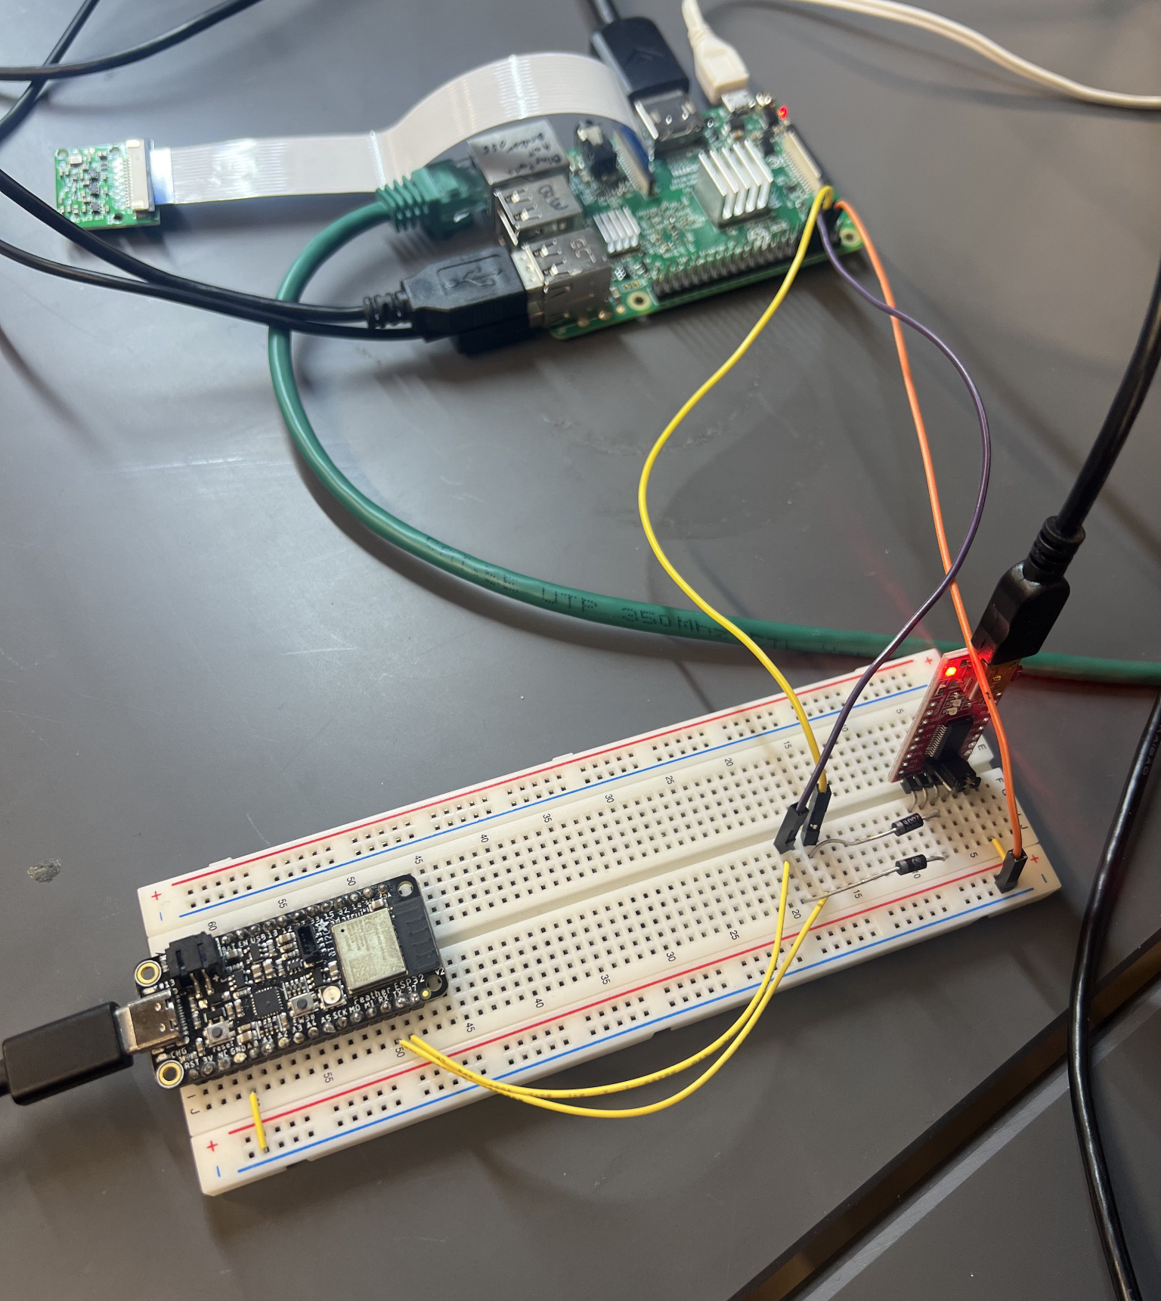
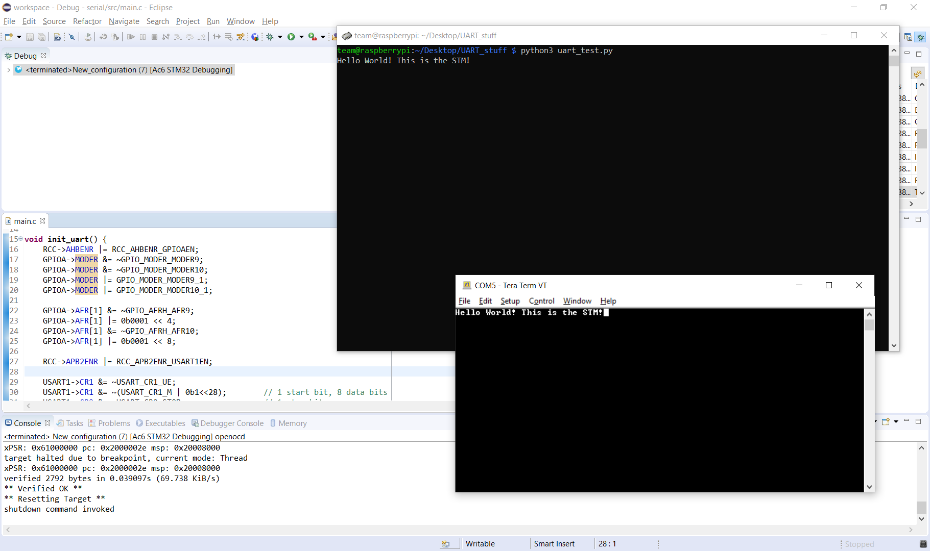
PROTOTYPING PROGRESS
UART Prototyping
Notes:
Brian

Slide 32
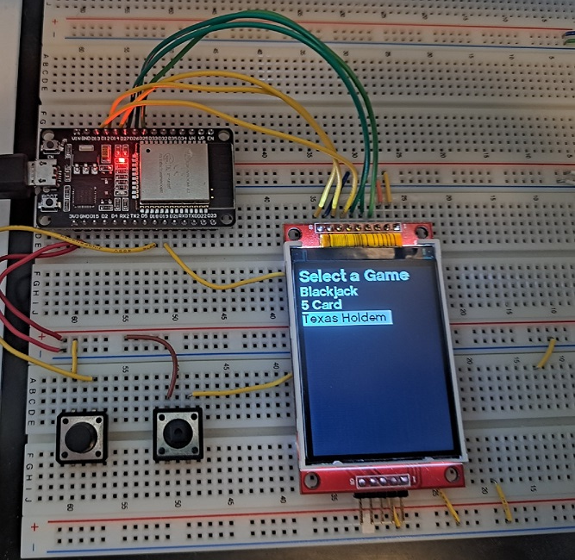
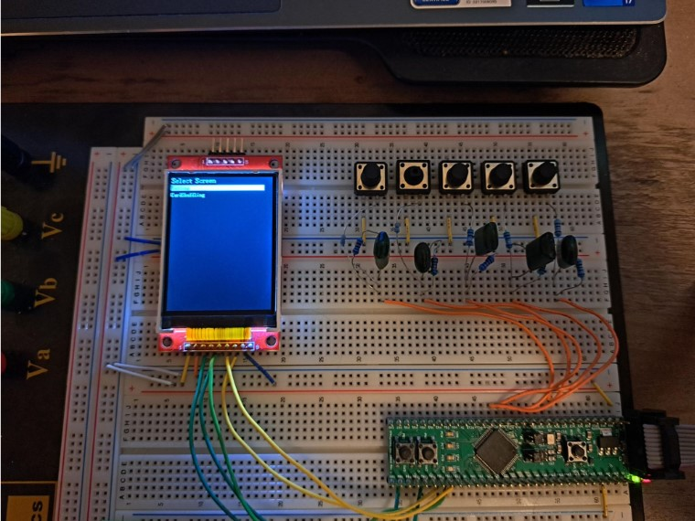
PROTOTYPING PROGRESS
LCD Screen and Push Buttons
Notes:
Zach

Slide 33
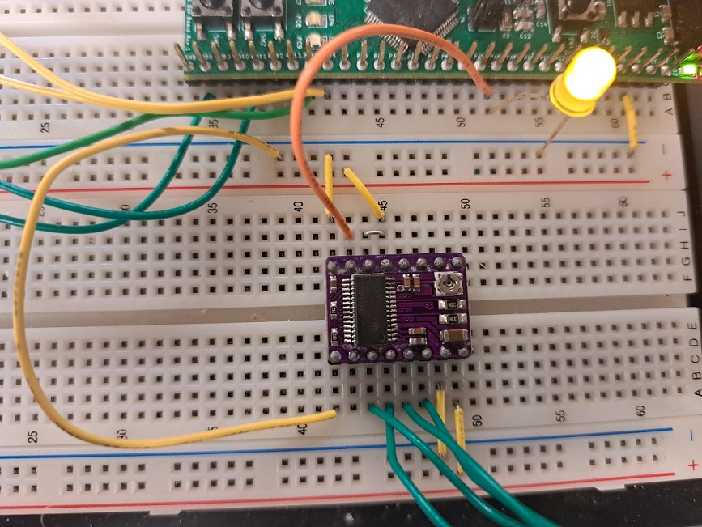
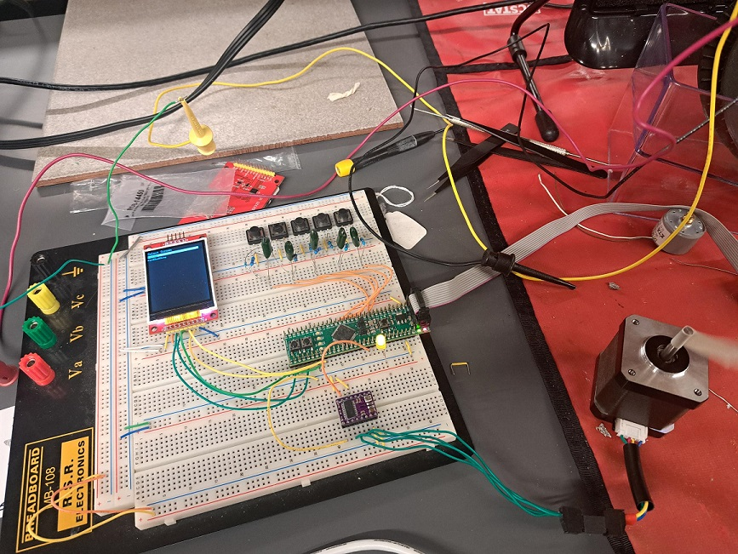
PROTOTYPING PROGRESS
Stepper Motor
Notes:
Zach

Slide 34
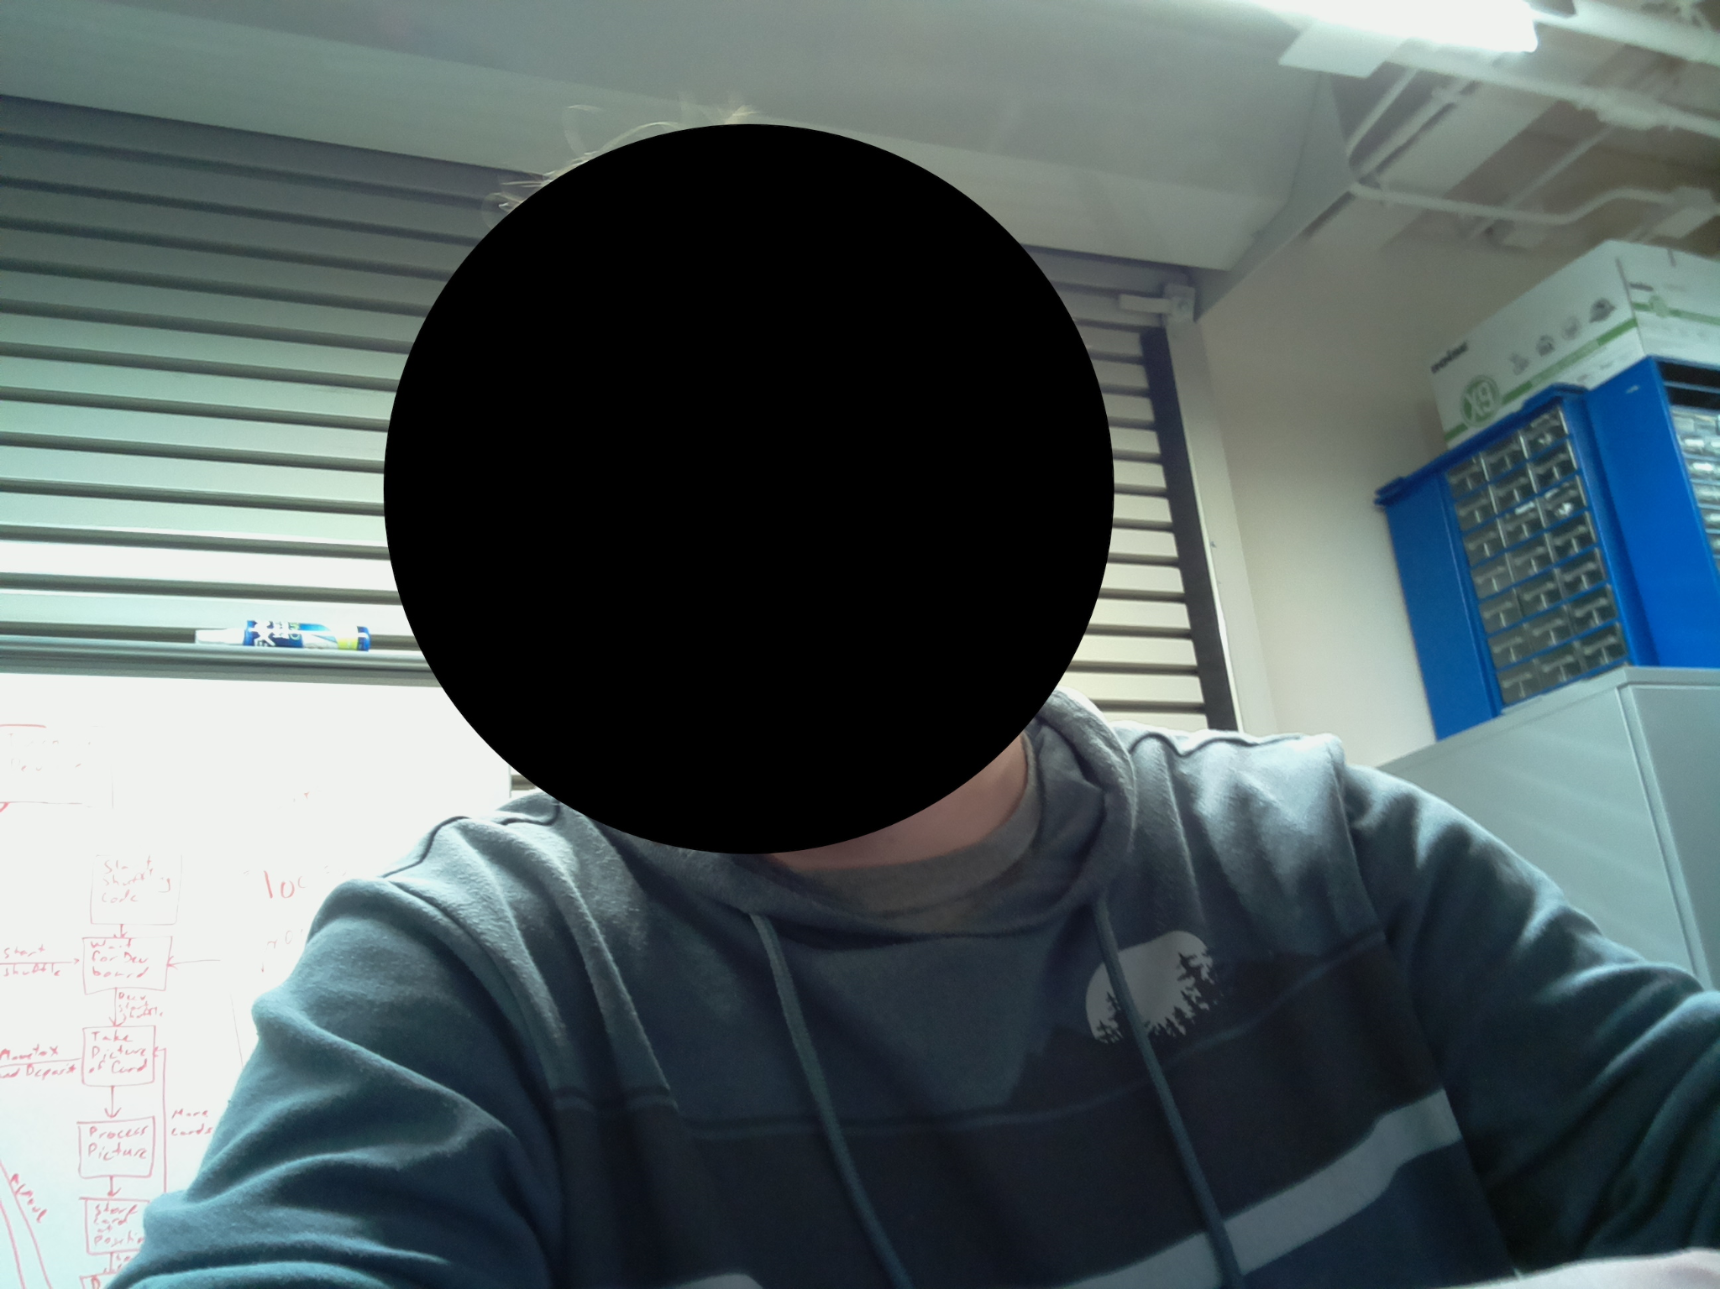
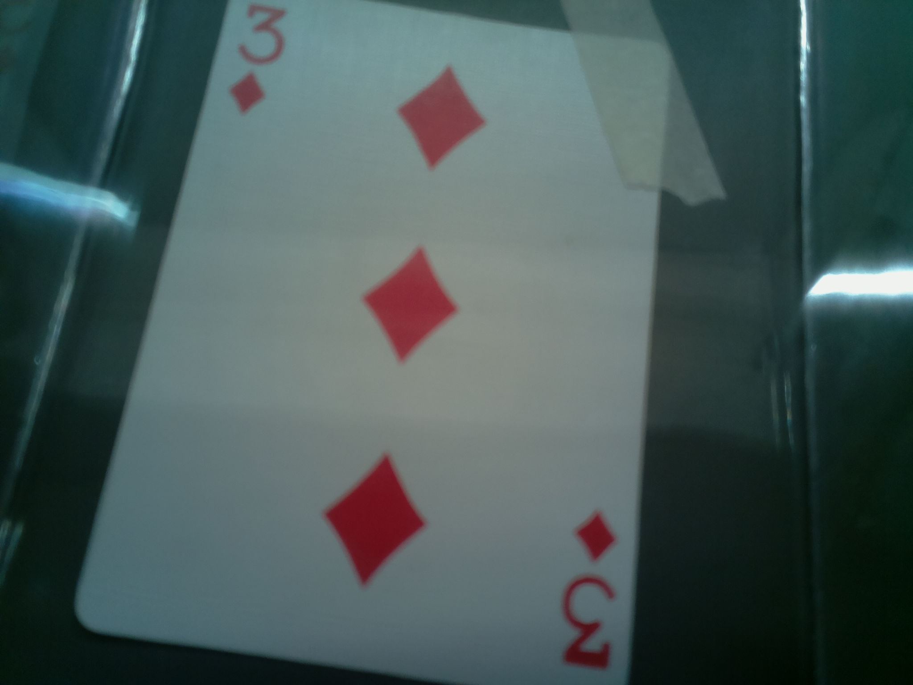
PROTOTYPING PROGRESS
Camera Image Capture
Notes:
Brian

Slide 35
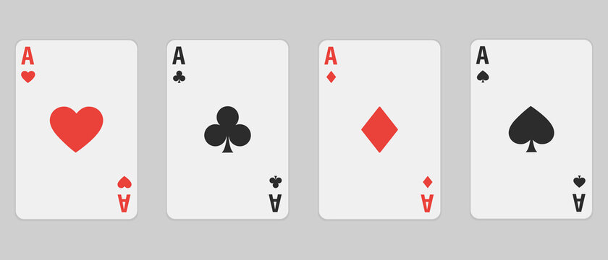
PROTOTYPING PROGRESS
Computer Vision
Notes:
Utkarsh

Slide 36
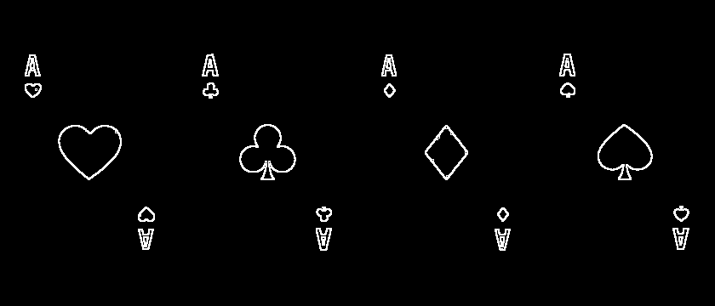
PROTOTYPING PROGRESS
Computer Vision
Notes:
Utkarsh

Slide 37
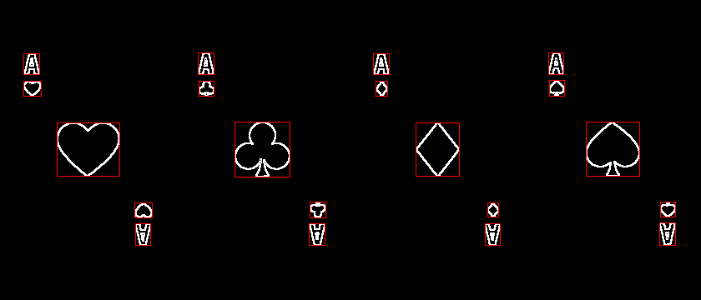
PROTOTYPING PROGRESS
Computer Vision
Notes:
Utkarsh

Slide 38

PROTOTYPING PROGRESS
Computer Vision
Notes:
Utkarsh

Slide 39

SOFTWARE DEVELOPMENT STATUS
Notes:
Utkarsh

Slide 40

SOFTWARE DEVELOPMENT STATUS
Notes:
Utkarsh

Slide 41

SOFTWARE DEVELOPMENT STATUS
Notes:
Utkarsh

Slide 42

PROJECT TIMELINE
Notes:
Zach

Slide 43
3D PRINTING
Questions?

